Slide 1
THE HOLOCAUST
The Early Years

Slide 2
HOLOCAUST
A burnt religious offering, willingly made
SHOAH
A destruction or calamity (an event that brings terrible loss, lasting suffering or severe affliction)
THE FINAL SOLUTION
The Nazi term for their planned annihilation of the Jews of Europe
Notes:
Many Jews prefer to refer to the Holocaust as the Shoah because they think the meaning of the word more accurately describes the horror of the event and the suffering of its victims and survivors.
The term Shoah is also used to differentiate between the genocide of the Jews and the Holocaust, which actually had a number of other targets

Slide 3
Anti-Semitism in Nazi Germany
First outlined by Hitler in Mein Kampf, anti-Semitic policies would lead to the murder of 6 million Jews by 1945.
Nazism blamed Jews for Germany’s problems including the Depression.
Notes:
6 million is equivalent to 2/3 of the Jewish population of Europe.
Jews were the primary targets of the Holocaust, which actually had approximately 11 million victims.
Other targets of the Holocaust included Gypsies, Poles and other Slavs, people with physical or mental disabilities, Jehovah's Witnesses, homosexuals and their political enemies (e.g. socialists).
As the Nazi invaded other countries they would send their Jews to ghettos and concentration camps

Slide 4
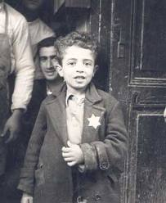
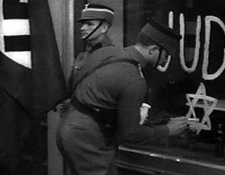
Early Persecution
Forced to wear a yellow Stars of David & carry identity cards.
Banned from owning property & most professions
Eventually most Jewish businesses & properties would be “Aryanized.”
Subjects of Nazi propaganda.
Notes:
Jews had to register all their wealth, property & businesses, which later helped in the “Aryanization” process.
They couldn’t serve in the military, hold government office or practice professions including teaching, medicine & dentistry.
Most well-known propaganda was a film and exhibit put together by Propaganda Minister Goebbels called “The Eternal Jew” that promoted Jewish stereotypes & Nazi theories about their danger to the world (called them a plague, compared them to rats, etc.).

Slide 5
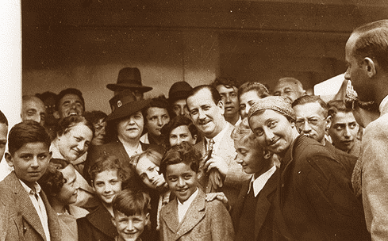
The St. Louis
Jews who attempted to leave Germany were often denied entry to other countries.
In May 1939, refugees on the St. Louis were turned away from Cuba, USA & Canada.
Eventually Britain, France, Belgium & Holland granted them asylum.
Notes:
There were 930 refugees on board.
Canada’s anti-Semitic immigration director Frederick Blair bragged about his success in denying European Jews entry into Canada.
The ship’s captain, Gustav Schroeder, was German but wanted to help his passengers find safe harbour. He planned to run the ship aground in Britain, light it on fire and evacuate the passengers, but in the end this extreme plan wasn’t necessary.
His Jewish passengers helped acquit him of Nazi collaboration.
He is honoured Yad Vashem Holocaust Memorial in Israel as one of the Righteous Among Nations.
When WWII broke out, many of the St. Louis passengers were trapped in Nazi occupied Europe.
About a third perished in concentration camps.
While the story of many refugee ships was similar, the St. Louis saga was well publicized and exploited by the Nazis for propaganda. The incident helped convince Hitler his Final Solution would not face opposition from the West.
In 2000, Canadian Christians invited them to a dinner in Ottawa. Church leaders wanted to honour the Jews and publicly express remorse. During the banquet, Baptist pastor Doug Blair – great nephew of the immigration director who rejected the St. Louis – addressed the 25 survivors: "I have come to beg your forgiveness for the…wrong that was done to you. I understand very well that my name is not one dear to your heart …will you forgive me and let me call you my friends?" The Jews rose spontaneously to embrace him.

Slide 6
The Nuremberg Race Laws
Passed in September 1935
Denied German Jews their citizenship
Defined a “full Jew” as anyone with 3 Jewish grandparents
Forbid sex & marriage between Jews & Aryans
Amendments to the law would deny Jews the status & rights of human beings

Slide 7
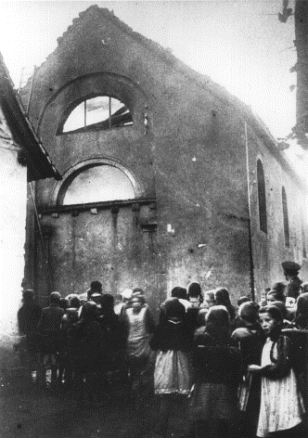
Kristallnacht
“Night of Broken Glass”
An organized retaliation after a Nazi official was shot by a Jewish man in Paris
91 Jews were killed, 7500 businesses were destroyed, 267 synagogues were burned & 25 000 men were sent to concentration camps
Notes:
Took place throughout Germany
Pogroms like these have taken place against Jews throughout much of European history
Jewish men, women and children were beaten, raped and terrorized
Their homes and synagogues were vandalized and burned

Slide 8
The Ghettos
Jews were segregated in small areas of major cities.
They were extremely crowded.
Harsh conditions caused many to die from starvation & disease.
Jews being forced to move into the Lodz ghetto
Notes:
Ghettos included Warsaw, Lodz, Vilna, Krakow
Several families were often forced to live in a single room.

Slide 9
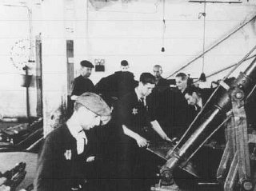
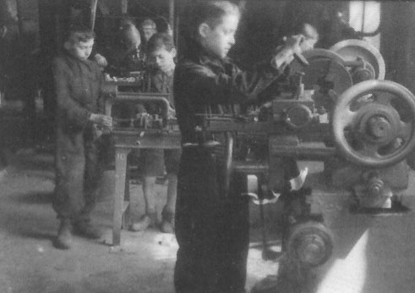
The Ghettos—Forced Labour
Everyone in the ghettos deemed fit for work—men, women and children—was forced to work.
Notes:
Top left: Women from the Lodz ghetto transport a container of excrement. Note: they are being used in lieu of beasts of burden.
Top right: Men from the Lodz ghetto work in a leather factory.
Bottom: Children from the Lodz ghetto work with heavy machinery.

Slide 10
The Ghettos—The Walls
In 1940, the Nazis ordered the ghettos sealed, and Jews were denied access to the rest of the city.
Notes:
The Jews were usually made to build the walls that would close them in. (picture of the Krakow ghetto wall construction with forced Jewish labour)

Slide 11
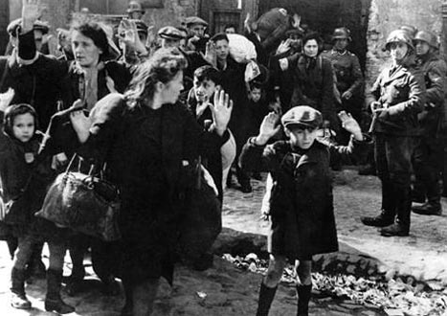
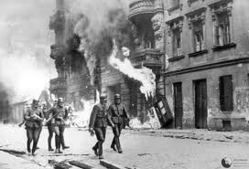
The Warsaw Ghetto Uprising
Supported by the Polish underground, Jews of the Warsaw Ghetto violently resisted its liquidation.
The fighting lasted from January-May of 1943.
Resisters were poorly armed & supplied—no match for the Nazi counterattack.
Residents were severely punished & ghetto was burned.
Notes:
The Nazis had already sent numerous residents of the Warsaw Ghetto to Treblinka. They were told they were being relocated for work. They could only bring what they could carry; their other belongings would be shipped later.
Rumours that Treblinka was a death camp and not a work camp leaked out and the remaining residents decided to resist their deportation.
Not many pictures of the fighting available. Nazis preferred to photograph their actions after they had successfully put down the uprising.
The Jews of the Warsaw ghetto were rounded up and either shot, transported to Treblinka or burned alive in the ghetto.

Slide 12
The UN definition of genocide:
Any of the following acts committed with intent to destroy, in whole or in part, a national, ethnic, racial or religious group:
Killing members of the group
Causing serious bodily or mental harm to members of the group
Deliberately inflicting on the group conditions of life calculated to bring about its physical destruction, in whole or in part
Imposing measures intended to prevent births within the group
Forcibly transferring children of the group to another group
Notes:
The lesson of the Holocaust is supposedly “never again.” Genocide has now been enshrined as a crime against humanity by the United Nations; its perpetrators can now be prosecuted for it, and in theory, the international community is forced to act if a genocide is taking place somewhere in the world.

Slide 13
THE HOLOCAUST
The Final Solution

Slide 14
The Wannsee Conference
Jan. 1942: SS officials plan the Final Solution.
Their goal: exterminate 11 million Jews.
Decided gas chambers would be the most efficient way of achieving this goal.
Ordered workers to speed up the construction of gas chambers & death camps.
Notes:
In the East (e.g. conquered parts of Russia) where the Holocaust was less organized, firing squads were used.
The Jews were usually forced to dig a mass grave.
They were lined up and shot.
Only one bullet per Jew, so if the bullet didn’t kill them they would be buried alive.
Local residents were forced to help with these killings (e.g. “stomp down” the bodies so more could be put in the grave or cover the grave when the executions were finished).
In most of Europe, the Nazis preferred the use of gas chambers which were more efficient--using bullets was also seen as wasteful as they were needed by soldiers on the front lines.
At some death camps, special trucks that could hold 80-100 Jews were used for the executions. The trucks had been modified so their exhaust was pumped into the cargo hold, asphyxiating the Jews.
It should be noted that mass killings had already taken place before this conference.

Slide 15
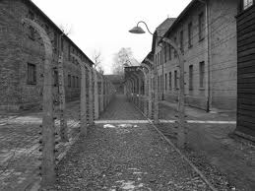
The Camps
All ghettos were liquidated & Jews sent to either concentration camps (slave labour) or death camps.
Upon arrival at death camps, Jews were divided into 2 groups:
Healthy enough to work (“productive annihilation”)
Unable to work, to be immediately gassed
Notes:
To prevent resistance, people were told they were simply being deported; they could bring only what they could carry & the rest of their belongings would follow.
People considered unfit for work included: the elderly, young children, pregnant & nursing women, the sick & injured, the disabled
If families refused to be separated, they would all be selected for execution
People sent to the gas chamber were told they would be taking showers in order to prevent panic.
Pictures: Auschwitz (top), a group of Jews selected for the gas chambers upon arrival at Auschwitz (bottom)

Slide 16
Map of the Camps
Notes:
Red=Death Camps
Green=Concentration Camps (forced labour)

Slide 17
Aerial View of Birkenau
Notes:
Birkenau was part of the Auschwitz complex
The transport trains, gas chambers and residential buildings can be seen. There are also dark lines visible—probably prisoners being marched from one location to another
Gas chambers 4 & 5 are clearly labeled to the top right, but gas chambers 2 & 3 can also be seen near the top on either side of the train tracks (the arrows are there, but the labels are cut off).
At Auschwitz, 2000 people could be gassed at once.
Initially people were gassed with carbon monoxide, but later Zyklon-B gas was introduced because it was faster.
To prevent mass graves from poisoning the ground water, the SS burned the corpses in crematory ovens.
For decades following the Holocaust, nothing could grow in the area surrounding the death camps because the ashes from these ovens were so plentiful, they damaged the soil.

Slide 18
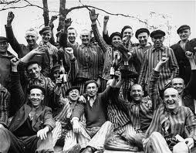
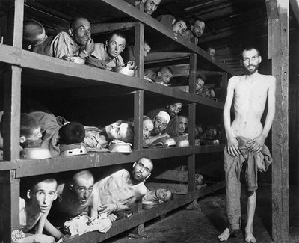
Liberation
Allied advance in 1944 began to liberate the concentration camps.
Winter 1944-45: outlying camps abandoned & Jews were sent on forced death marches to camps farther away from the front lines.
As the camps were liberated, the true horrors of the Holocaust became known.
Notes:
Executions were often stepped up before the camps were abandoned.
Those unfit for marching were left behind in the camps.
Often forced to march without food, water or sleep
Anyone who could not keep up on the march was shot.
The full extent of the Holocaust became known at liberation, but the outside world was certainly aware of the mistreatment of Jews before that time.
Top picture: Auschwitz
Middle: Dachau
Bottom: Buchenwald (Elie Wiesel is the man in the middle row, 7th from left)

Slide 19
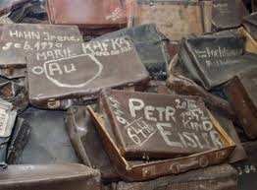
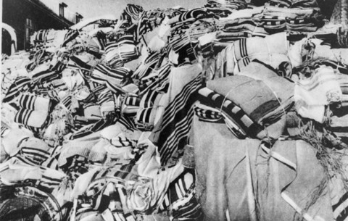
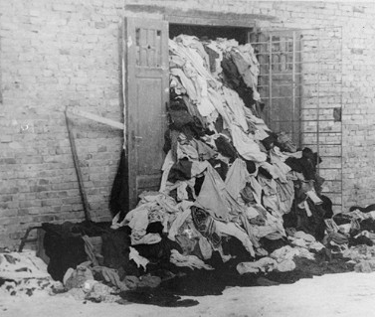
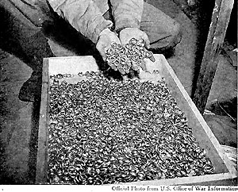
Notes:
Visible in these photos are clothing, prayer shawls, suitcases and wedding rings confiscated from the Jewish prisoners. The extent of the horror is evident even without seeing the mass graves. All of the Jews possessions were stored to be used later by the German people—even the hair shaved off before their executions and the gold teeth extracted from the dead.

Slide 20
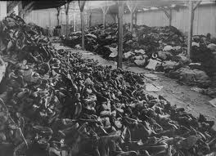
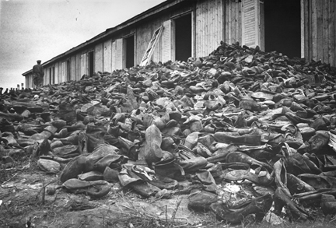
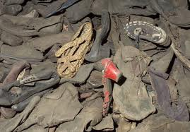
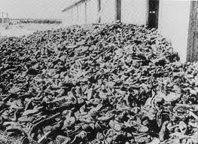
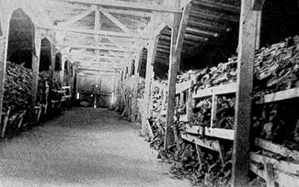
Notes:
Read poem “A Load of Shoes” written by Avraham Sutzkever (pronounced Ahv-rahm Zoots-kev-er)
Written in the Vilna ghetto in January 1942 before the iconic images you see on the screen were taken.
By the time he escaped the ghetto a year later (smuggling his poems with him), most of the Jews from the ghetto would have been executed in a nearby forest.
Many Jews kept records of their experiences in the ghetto even though it was forbidden. The Jews of the Warsaw ghetto, for example, buried poems, stories, diaries & archives before the liquidation that were uncovered years later.
Literature can be a form of resistance. The words of many have survived to protest what happened to them and make it impossible for a cover up to take place.

Slide 21
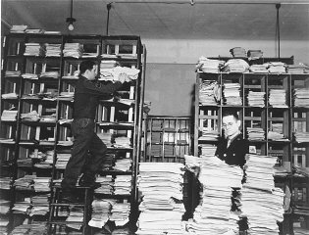
The Nuremberg Trials
Conducted jointly by USA, Britain, France & USSR, the trials began in November 1945.
High-ranking Nazis were tried for war crimes & crimes against humanity.
Evidence against them included their own extensive documentation of the Final Solution.

Slide 22
“I believe that it was really due to Lorenzo that I am alive today; and not so much for his material aid, as for his having constantly reminded me by his presence . . . That there still existed a just world outside our own, something and someone still pure and whole . . . for which it was worth surviving.”
Primo Levi writing about his rescuer, Lorenzo Perrone
Notes:
Yad Vashem is a museum dedicated to memorializing the Holocaust in Israel. One of the things they do is honour those who they call The Righteous Among Nations, those who, at great risk to themselves, helped someone survive the Holocaust.
The museum only honours non-Jews with this title though there are numerous accounts of Jews who were also willing to risk their safety to help another Jew.
It is inspiring to know that at a time when so many chose to be bystanders—even perpetrators—there were also many who were willing to risk their personal safety and their lives to help others. The list of the Righteous Among Nations contains the names of over 22 000 men and women from 44 countries. They include Christians, Muslims and agnostics; highly educated university professors and illiterate farmers—people from all walks of life.
Whether they provided a hiding place or false papers and identities, helped someone escape or rescued a child, each one of the 22 000 saved a life—some of them saved hundreds. The most famous of the righteous is probably Oskar Schindler thanks to the movie Schindler’s List, but here are five other stories of people who showed basic human decency and kindness in the midst of one of the most inhuman events in world history.

Slide 23
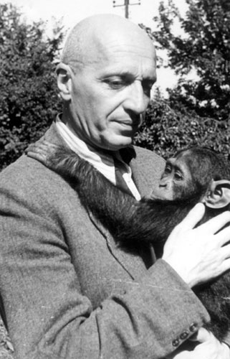
Dr. Jan and Antonina Zabinski (Poland)
Jan was director of the Warsaw Zoo, and along with his wife, he hid many Jews in his home or in abandoned cages at the zoo before helping them relocate to permanent places of refuge.
Notes:
Pictures: Jan and Antonina before the war with animals from the zoo.

Slide 24
The Viseli Family(Albania)
The Viselis were a Muslim family who smuggled two Jewish families from the city of Tirana to their parents’ home in the mountains, where they hid until the end of the war.
Notes:
Picture: the Viselis with the Mandils, one of the families they saved at their mountain home in Kruja.

Slide 25
Chiune Sempo Sugihara (Japan)
An ambassador to Lithuania when the Nazis invaded, Sugihara issued 3500 visas to Jews who needed them to travel through the USSR to the Dutch colony of Curacao where they were seeking refuge. He took this action against the wishes of his own government.
Notes:
Jewish refugees looking to leave Europe in the wake of Nazi persecutions often had difficulty leaving because most countries required visas before you could enter. Curacao did not, which is why the group Sugihara helped were looking to go there.
After the Nazi take over, Sugihara was being called home to Japan. There are stories of him stamping visas at the train station right up until the moment he had to board the train that would take him out of Lithuania. Apparently he even allowed some of the Jews to stamp their own visas because they couldn’t read the Japanese and some of the visas were stamped upside-down.
He lost his job for his actions, but is today considered a hero in Japan.

Slide 26
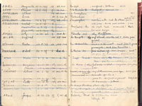
Andrée Geulen (Belgium)
Geulen was a teacher who worked with the Jewish Defense Committee to help hundreds of Jewish children go into hiding with Christian families and in monasteries. After the war, she used the extensive lists she had kept to return the children to surviving family members.
Notes:
Geulen was also one of the teachers who helped her principal, Odile Ovart, hide 12 Jewish children in the boarding school where she worked.

Slide 27
The Village of Nieuwalande (Netherlands)
All 117 inhabitants of the village agreed to hide either a single Jewish person or an entire Jewish family.
Notes:
The villagers were safe from detection because their shared “guilt” meant no one in the village would betray them, a risk that most other rescuers took.
The village of Le Chambon-sur-Lignon in France did the same, hiding Jews until they could obtain the false papers they would need to escape over the border into Switzerland. As Huguenots, French Protestants who had been persecuted for centuries in what was once a predominantly Catholic nation, they sympathized with the plight of the Jews. It is estimated that the villagers saved the lives of 3000-5000 Jews.
Every horrible human tragedy has stories like these that act like light in the darkness. A few examples from Rwanda:
Romeo Dallaire, a Canadian Commander of UN peacekeepers in Rwanda at the time the genocide began. He repeatedly sought reinforcements to help end the violence and when he was denied—the majority of his PKs were ordered out of Rwanda—he focused his efforts and his remaining forces on protecting areas where Tutsis were known to be hiding. He is credited with saving 32 000 lives.
Paul Rusesabagina, the manager for the Hotel des Milles Collines, who bribed the Hutu militia with money and alcohol to keep them from killing the 1200 Tutsis hiding in his hotel.

